Slide 1
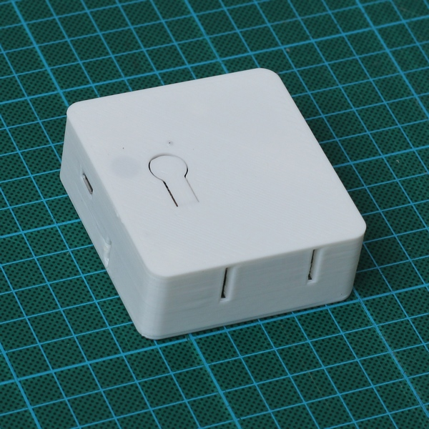
vThings – CO2 Monitor
NDIR CO2 Sensor
Wi-Fi Connectivity (HTTP/MQTT)
Very Customizable Firmware
Upgrades for CO2 Sensor
No Calibration
Up to 10,000 PPM
Higher accuracy
Low Power
Additional Sensors
Dust 0-1000 um3
Temperature
Humidity
Pressure

